Slide 1

Continual Test-Time Domain Adaptation
CVPR 2022

Slide 2

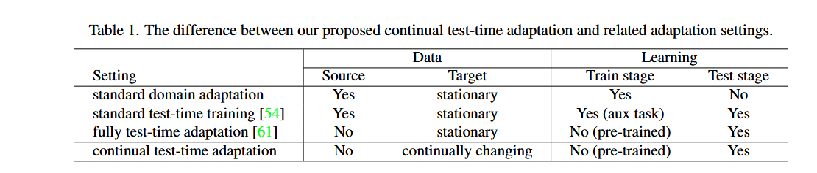
Background

Slide 3
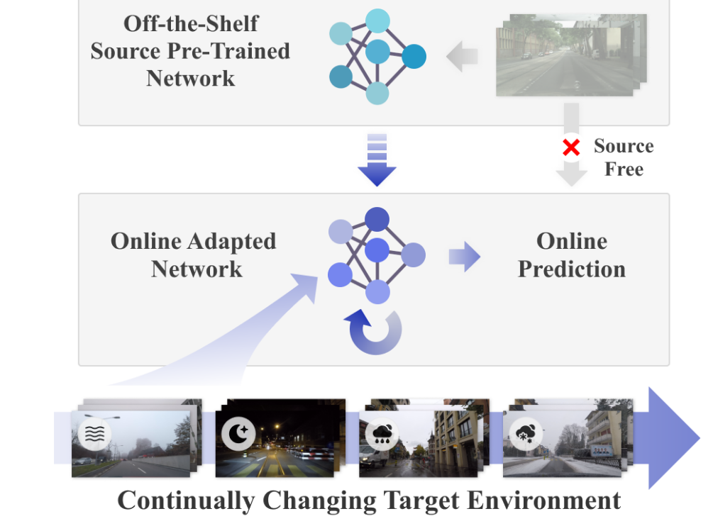
Background
Existing methods, which are mostly based on self-training and entropy regularization, can suffer from these non-stationary environments.
Due to the distribution shift over time in the target domain, pseudo-labels become unreliable.
The noisy pseudolabels can further lead to error accumulation and catastrophic forgetting.

Slide 4
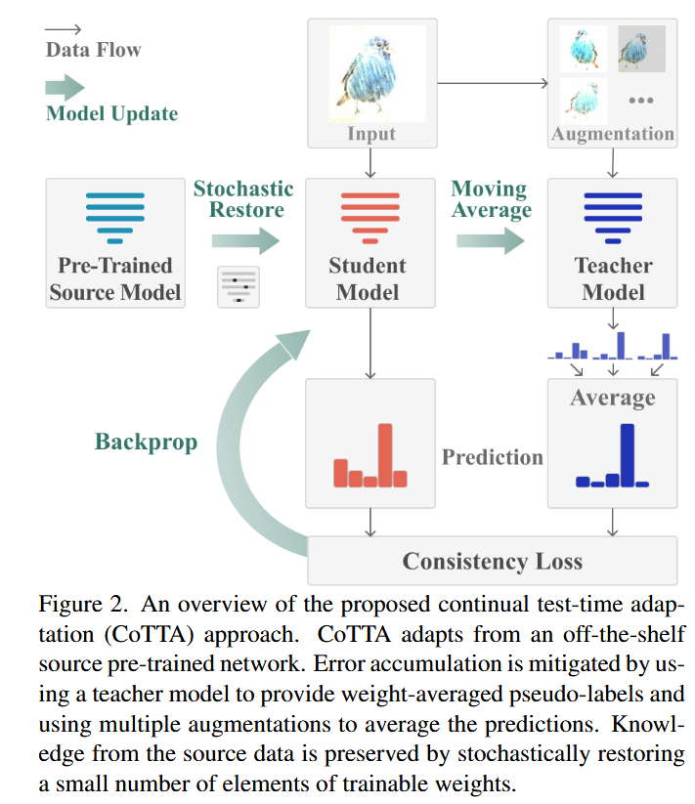
Methods
Methodology
1、Weight-Averaged Pseudo-Labels
2、Augmentation-Averaged Pseudo-Labels
3、Stochastic Restoration

Slide 5
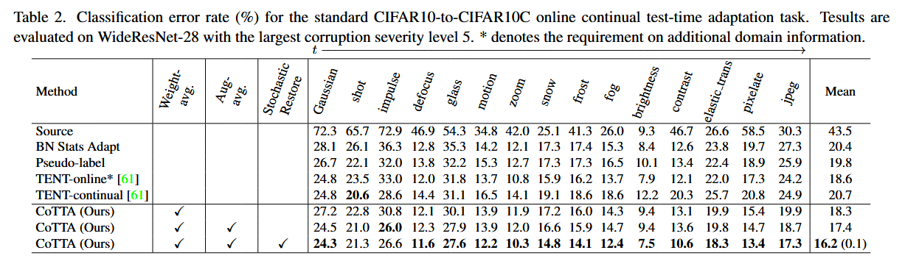
Experiments

Slide 6
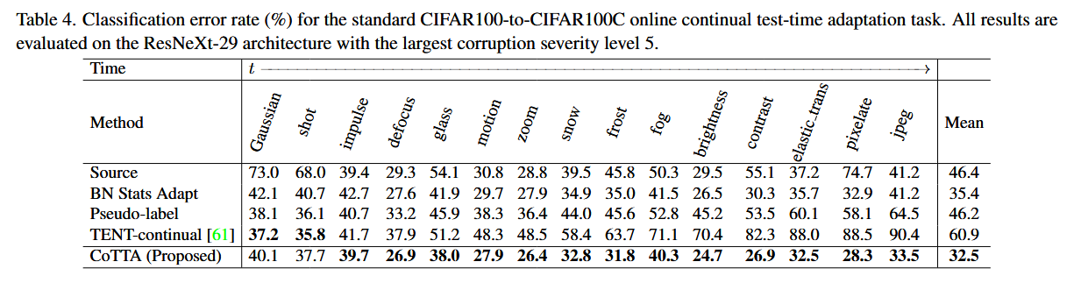
Experiments

Slide 7
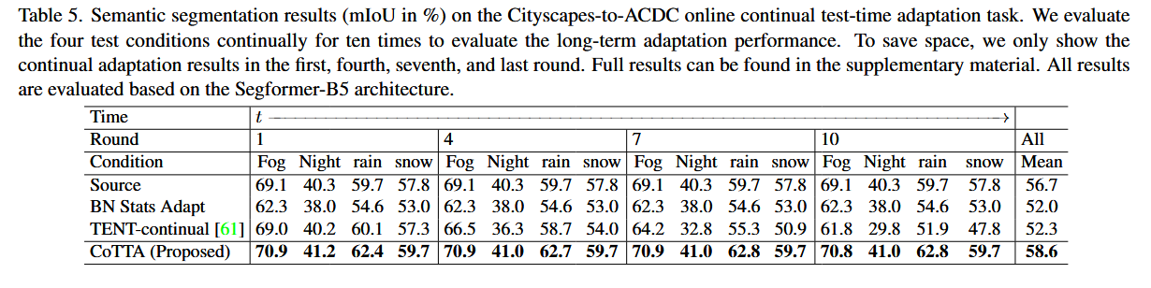
Experiments

Slide 8

Thanks

